Slide 1
Chapter 12
Respiration

Slide 2
Respiration: is the process by which energy is released from food.
It is a chemical process, which takes place inside cells. The food mainly used is glucose.
Types of respiration
A- Aerobic respiration
Aerobic means that oxygen is involved in the chemical reaction.
It produces carbon dioxide and water.
It releases a big amount of energy.

Slide 3
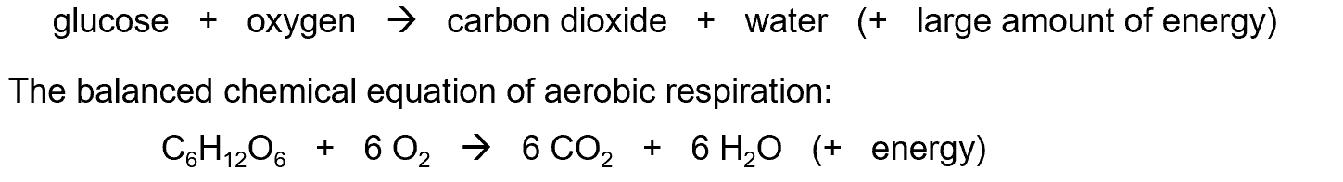
Aerobic Respiration
The overall reaction of aerobic respiration:

Slide 4
Anaerobic Respiration
B- Anaerobic Respiration
Anaerobic means in the absence of oxygen,
The fermentation of glucose by yeast gives alcohol and carbon dioxide,
A small amount of energy is released.

Slide 5
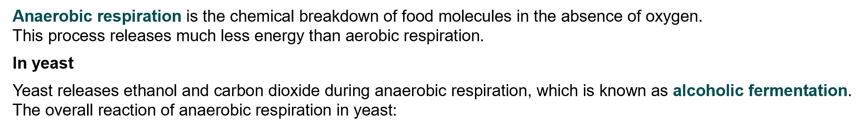
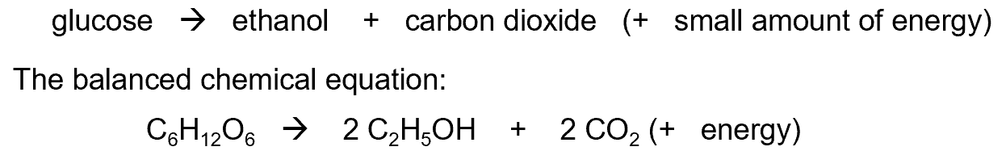
Anaerobic Respiration

Slide 6
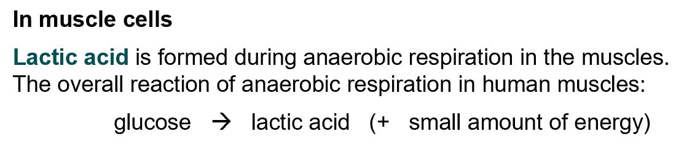
Anaerobic Respiration

Slide 7
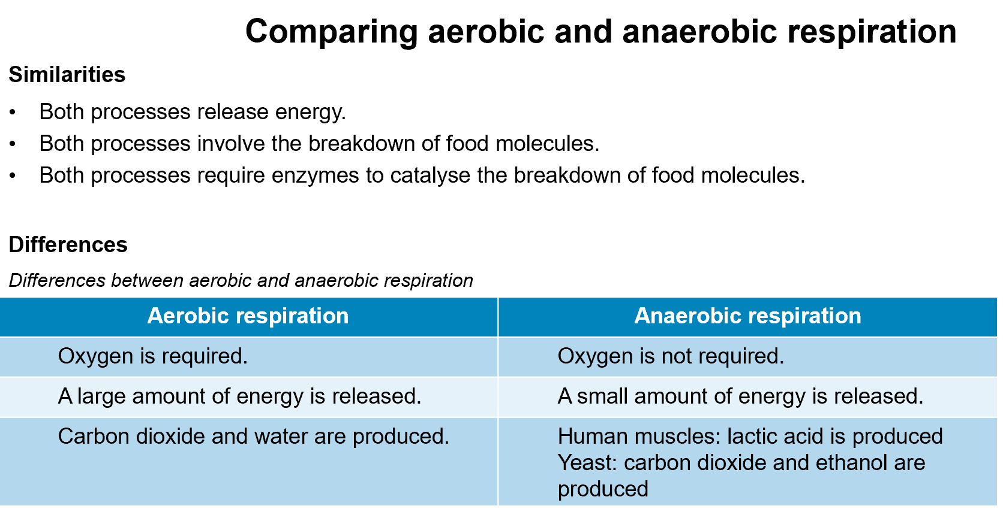

Slide 8
Uses Of Energy
Uses of energy
Energy is used for
Muscle contraction and movement.
Conduction of nerve impulses across nerve fibers.
Active transport.
Protein synthesis and therefore for growth.
Cell division.
Maintenance of body temperature.

Slide 9
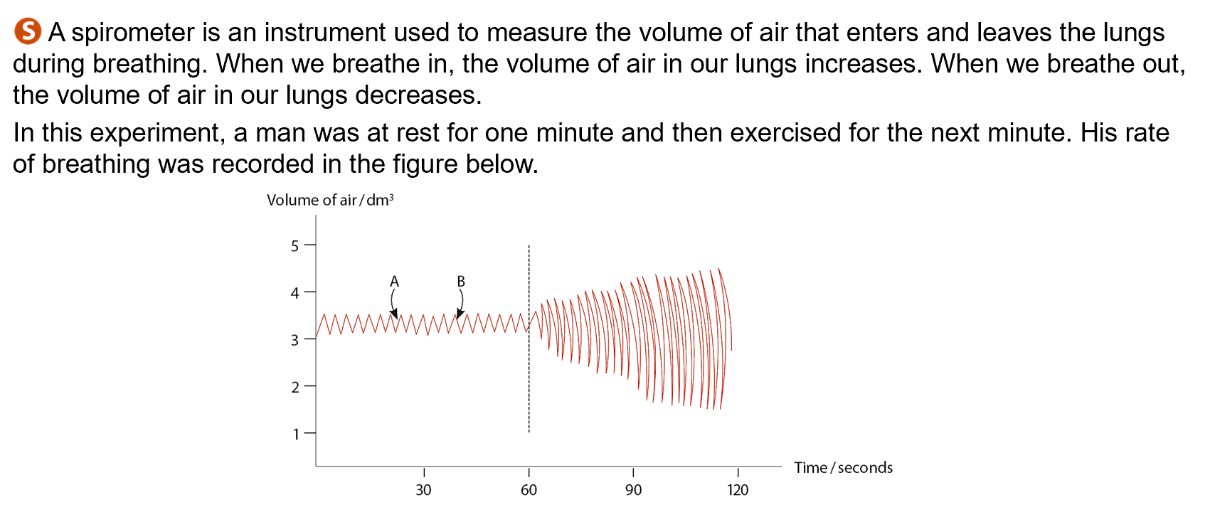

Slide 10
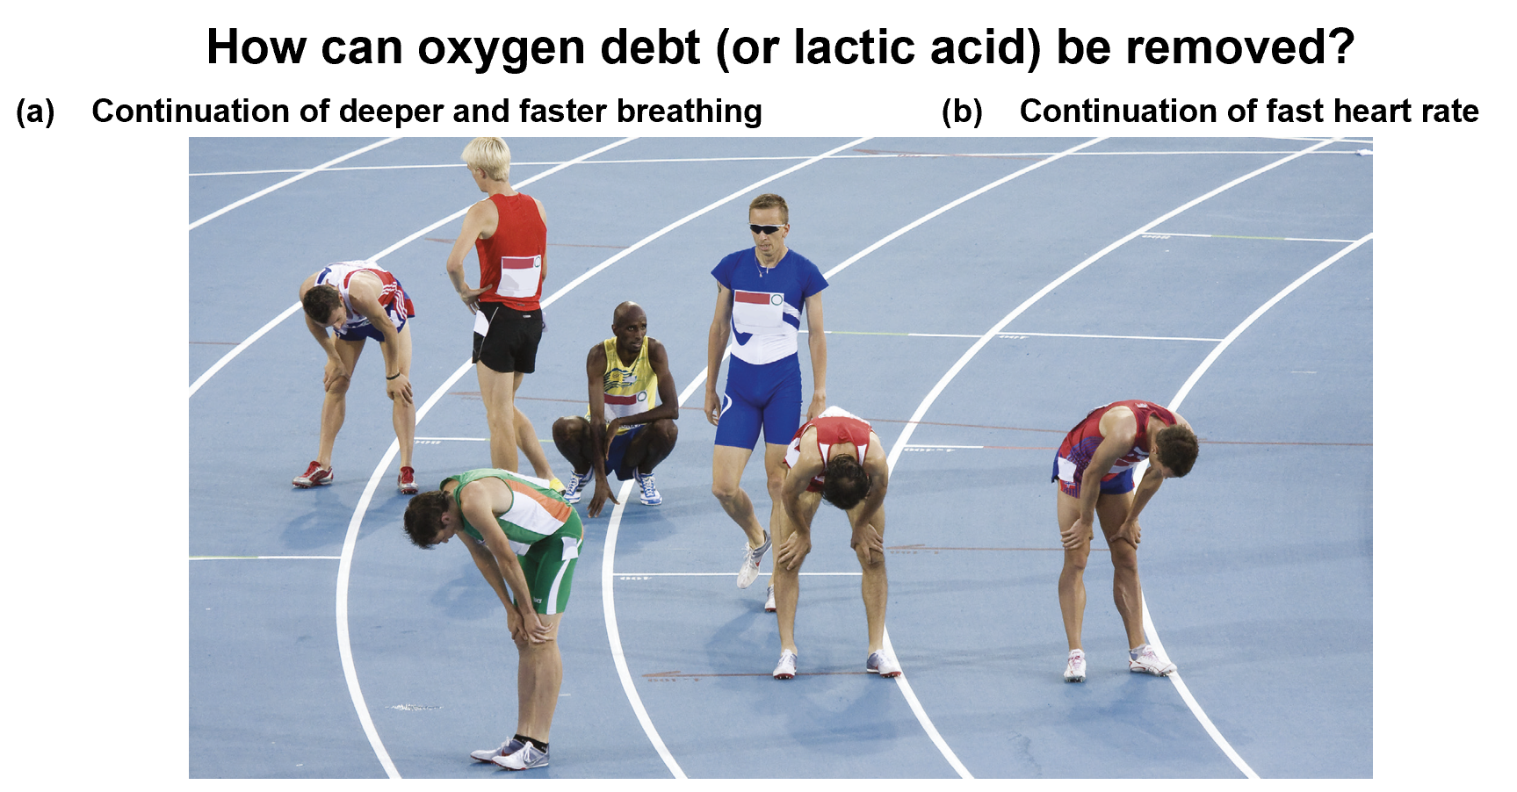

Slide 11
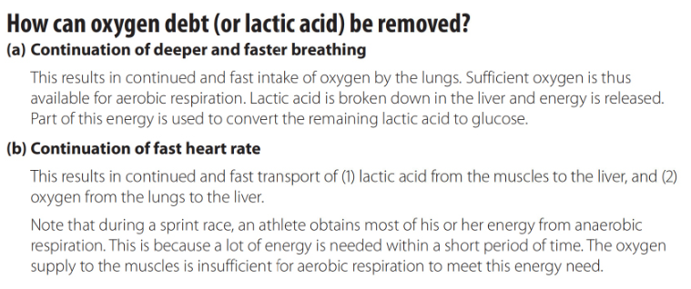

Slide 12
Metabolism
All the chemical reactions taking place inside cells.
Metabolic reactions are of two kinds:
1 Catabolic reactions: break substances down into simpler ones.
e.g. Respiration.
Catabolic reactions release energy.
2 Anabolic reactions: build up substances from simpler ones.
e.g. Synthesis of proteins from amino acids. Anabolic reactions need energy to occur.

Slide 13
Practical Part
Soda lime: absorbs carbon dioxide from the air.
Water bath: prevents temperature variations.
Control experiment: use dead seeds, which are killed previously
by boiling.
Note: in an experiment having an animal, a control experiment may include an equivalent volume of glass beads.
Definition of control experiment: is a second experiment set up where all variables are kept the same except the one being tested.

Slide 14
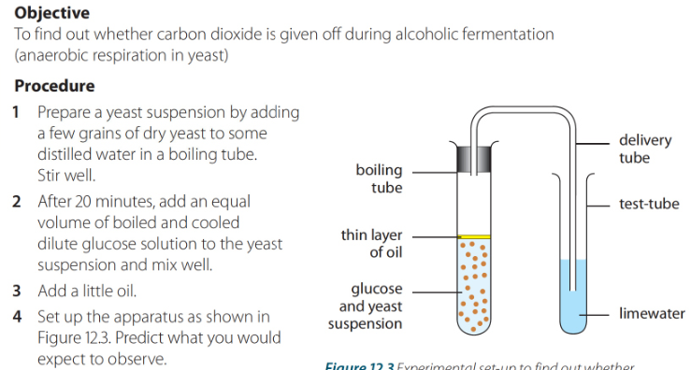
How do we know that living organisms respire?
Explanation:
In the absence of oxygen, yeast ferments sugar( anaerobic respiration. Carbon dioxide released turns lime water milky. At the end of the experiment, alcohol is found in the original tube
For a control experiment, set up the same experiment but with dead yeast

Slide 15
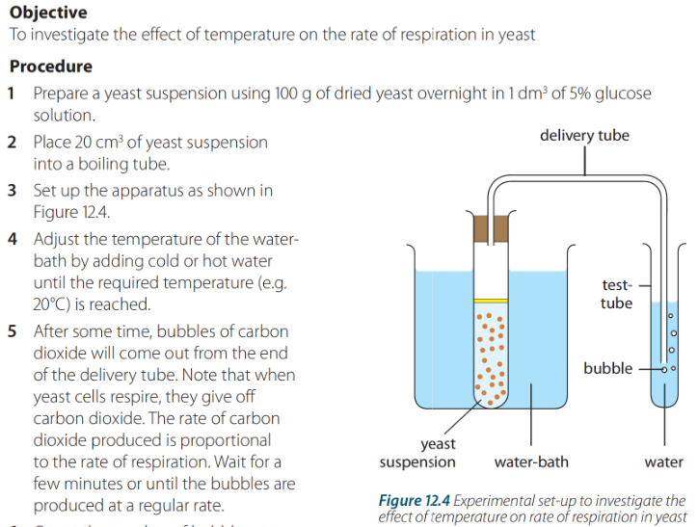
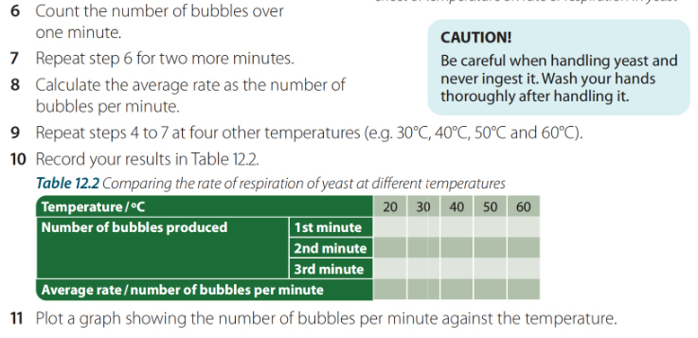
Th effect of temperature on the rate of respiration

Slide 16
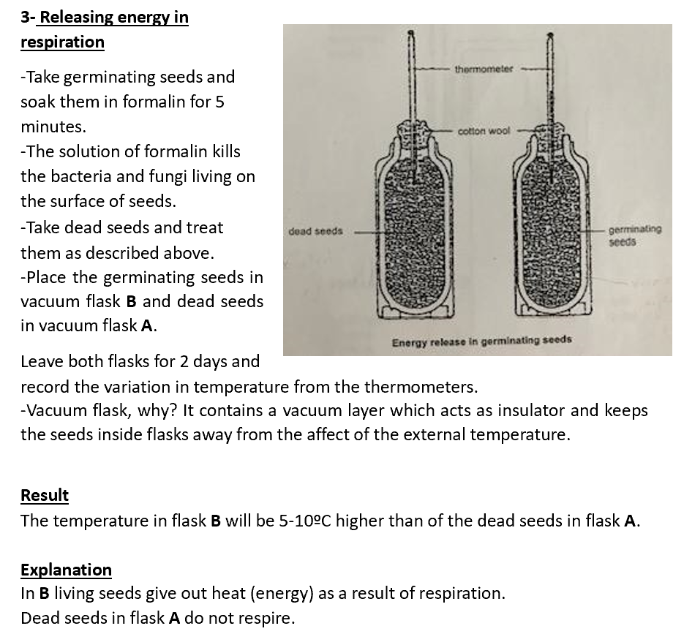
Relaesing energy in respiration

Slide 17
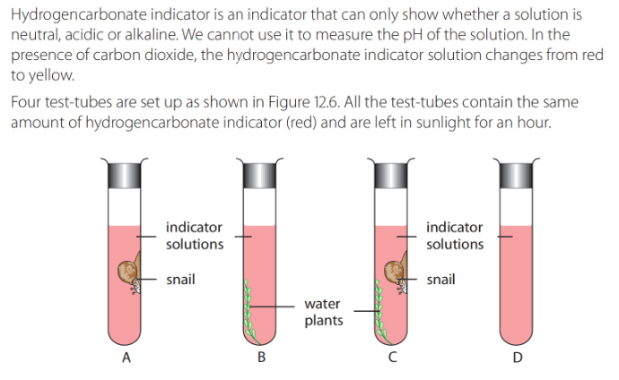
Color indicator Experiment
Explanation:
A: yellow color, snail will respire and give out CO2 that dissolves in water to form carbonic acid.
B: purple. Green plant will photosynthesize removing all CO2 from the medium
C: Any CO2 released by snail will be used by the plant for photosynthesis. The rate of respiration is equal to the rate of photosynthesis.
D: is control experiment( for comparison)

